Slide 1
CSE 260
BRAC University

Slide 2

Boolean Functions (Solve ?)
Examples:
F1= xyz'
F2= x + y'z
F4=xy'+x'z
F3=(x'y'z)+(x'yz)+(xy')
SOP,
minte-rm
From the truth table, F3=F4.
Can you also prove by algebraic manipulation that F3=F4?

Slide 3
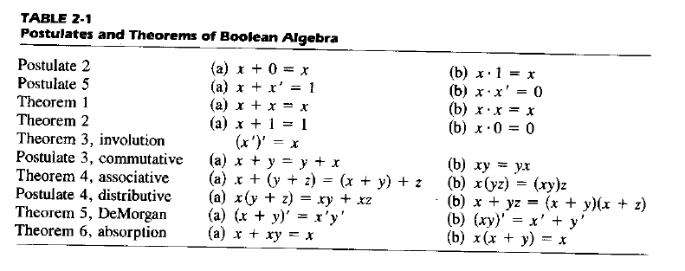
Try it yourself: simplify the following equations
1. f(a,b,c,d) = abc + abd + a'bc' + cd + bd'

Slide 4
Drawing Logic Circuit
(ii) F2 = x + y'z (can assume that variables and their complements are available)
x
F2
y'
z
y'z
(iii) F3 = xy' + x'z
x
xy'
y'
F3
x'
z
x'z

Slide 5
Analysing Logic Circuit
When a logic circuit is provided, we can analyse the circuit to obtain the logic expression.
Example: What is the Boolean expression of F4?
A'
B'
C
A'B'
A'B'+C
(A'B'+C)'
F4
F4 = (A'B'+C)'

Slide 6
Review
If expression F2= x + y'z is given, below is its truth table (obtained by “AND”ing y’ with z and then “OR”ing the product with x.)
So from truth tabe, considering the 1’s
we can say,
F2=x’y’z+xy’z’ + xy’z + xyz’ + xyz
which when simplified using postulates,
will result to,
F2=x+y’z
so x+y’z = x’y’z+xy’z’ + xy’z + xyz’ + xyz
X | Y | Z | F2
0 | 0 | 0 | 0
0 | 0 | 1 | 1
0 | 1 | 0 | 0
0 | 1 | 1 | 0
1 | 0 | 0 | 1
1 | 0 | 1 | 1
1 | 1 | 0 | 1
1 | 1 | 1 | 1
Simplified expression
SOP Canonical Format of the expression

Slide 7
Review: Solve it yourself
Q1. Draw a logic circuit for BD + BE + D’F
Q2. Draw a logic circuit for
A’BC + B’CD + BC’D + ABD’

Slide 8
Review: Solve it yourself
What is Boolean expression of F5?
x
y
F5
z

Slide 9

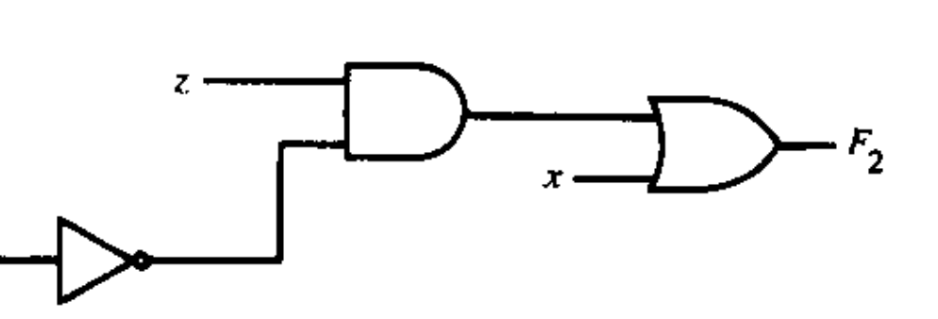

Review: Solve it yourself
What is Boolean expression of F2?
F2=zy’+x

Slide 10
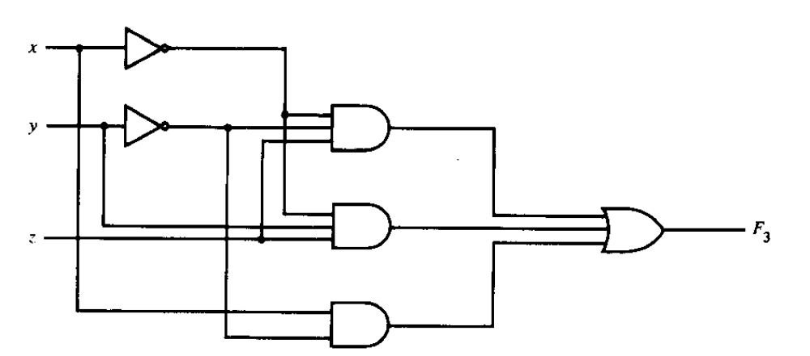
Review: Solve it yourself
What is Boolean expression of F3?
F2=x’y’z+x’yz+xy’

Slide 11
Standard Forms
Two Standard Forms: Sum-of-Products and Product-of-Sums
Literals: a variable on its own or in its complemented form. Examples: x, x' , y, y'
Product Term: a single literal or a logical product (AND) of several literals.
Examples: x, xyz', A'B, AB

Slide 12
Standard Forms
Sum Term: a single literal or a logical sum (OR) of several literals.
Examples: x, x+y+z', A'+B, A+B
Sum-of-Products (SOP) Expression: a product term or a logical sum (OR) of several product terms.
Examples: x, x+yz', xy'+x'yz, AB+A'B'
Product-of-Sums (POS) Expression: a sum term or a logical product (AND) of several sum terms.
Examples: x, x(y+z'), (x+y')(x'+y+z), (A+B)(A'+B')
Every boolean expression can either be expressed as sum-of-products or product-of-sums expression.
Examples:
SOP: x′y + xy′ + xyz
POS: (x + y′)(x′ + y)(x′ + z′)
Note: SOP and POS are complements

Slide 13
Minterm
Consider two binary variables x, y.
Each variable may appear as itself or in complemented form as literals (i.e. x, x' & y, y' )
For two variables, there are four possible combinations with the AND operator, namely:
x'y', x'y, xy', xy
These product terms are called the minterms.
A minterm of n variables is the product of n literals from the different variables.
In general, n variables can give 2^{n} minterms.

Slide 14
Maxterm
In a similar fashion, a maxterm of n variables is the sum of n literals from the different variables.
Examples: x'+y', x'+y, x+y',x+y
In general, n variables can give 2^{n} maxterms.

Slide 15
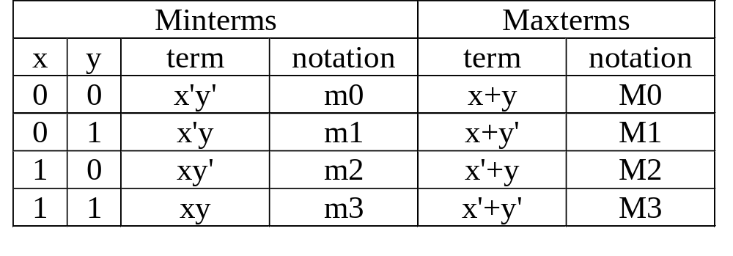
Minterm & Maxterm
The minterms and maxterms of 2 variables are denoted by m0 to m3 and M0 to M3 respectively:
Note:
m₀=x’y’z’
m₀’=xyz
M₀=(x+y+z)
m₀’= M₀
Minterm number is the decimal representation
Each minterm is the complement of the corresponding maxterm:
Example: m2 = xy'
m2' = (xy')' = x' + (y')' = x'+y = M2

Slide 16
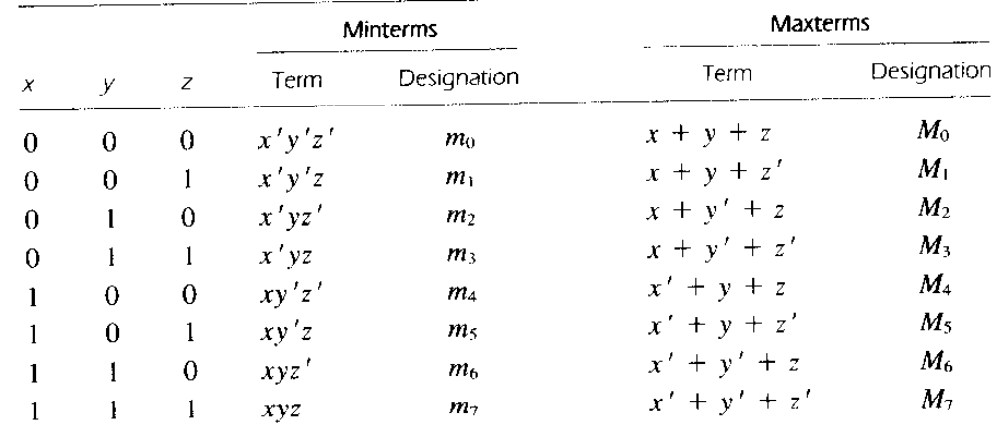
Minterms and Maxterms

Slide 17
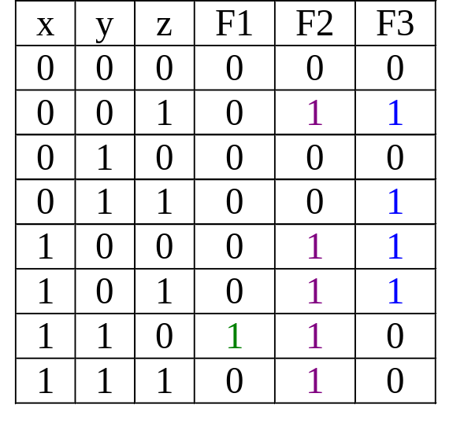
Canonical Form: Sum of Minterms
Obtain Sum-of-Minterms by gathering/summing the minterms of the function (where result is a 1)
F1 = xyz' = Σ(m6)
F2 = x'y'z+xy'z'+xy'z+xyz'+xyz = Σ(m1,m4,m5,m6,m7)
F3 = x'y'z+x'yz+xy'z'
+xy'z
= Σ(m1,m3,m4,m5)

Slide 18
Canonical Form: Product of Maxterms
Maxterms are sum terms.
For Boolean functions, the maxterms of a function are the terms for which the result is 0.
Boolean functions can be expressed as Products-of-Maxterms.

Slide 19
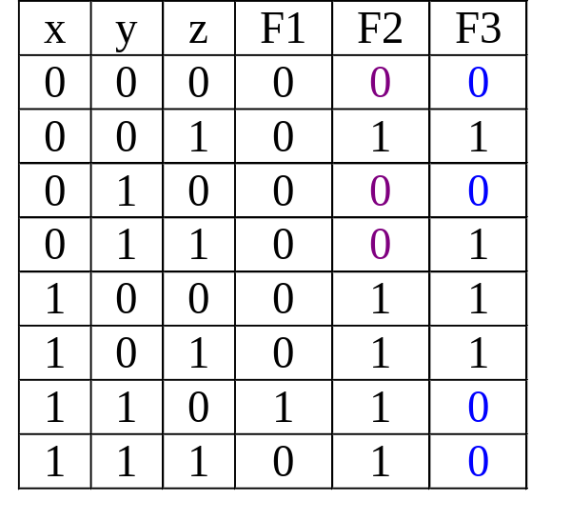
Canonical Form: Product of Maxterms
E.g.: F2 = Π(M0,M2,M3) = (x+y+z)(x+y'+z)(x+y'+z')
F3 = Π(M0,M2,M6,M7)
= (x+y+z)(x+y'+z)(x'+y'+z)(x'+y'+z')

Slide 20
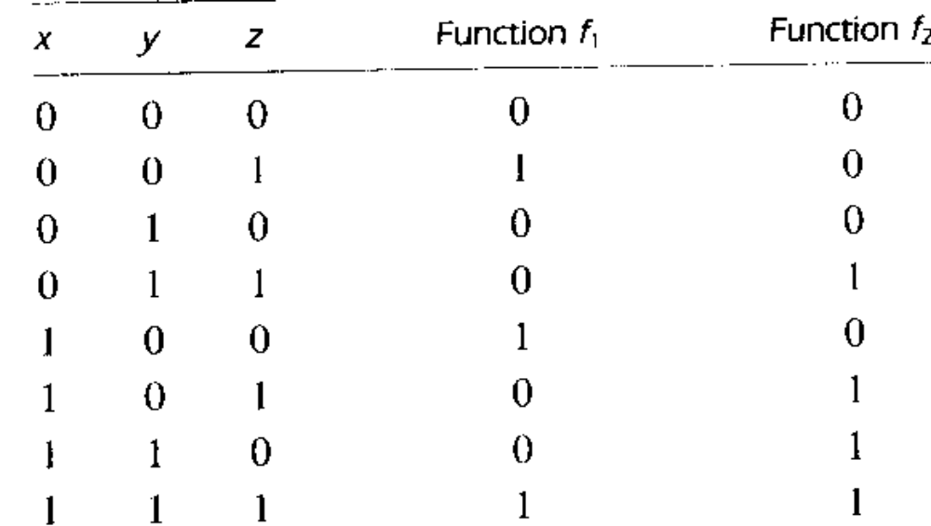
SOP
->POS
Considering the 1’s-> f₁=x’y’z+xy’z’+xyz’=m₁+m₄+m₇
=∑ (m_{1,}m₄,m₇ )
Considering the 0’s -> f₁’=x’y’z’+x’yz’+x’yz+xy’z+xyz’=m₀+m₂+m₃+m₅+m₆
(f₁’)’=f₁=(x+y+z)(x+y’+z)(x+y’+z’)(x’+y+z’)(x’+y’+z)
f₁=M₀M₁M₂M₅M₆ =∏(M_{0,}M_{2,}M_{3,}M_{5,}M₆₎
Try writing f₂ in (i) SOP and (ii) POS

Slide 21
Solution
SOP: F2 =x’yz+xy’z+xyz’+xyz
POS: F2=(x+y+z)(x+y+z’) (x+y’+z)(x’+y+z)

Slide 22
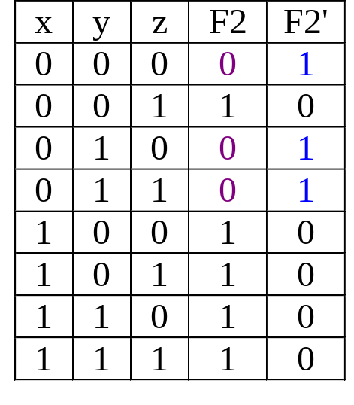
Canonical Form: Product of Maxterms
Why is this so? Take F2 as an example.
F2 = Σ(m1,m4,m5,m6,m7)
The complement function of F2 is:
F2' = Σ(m0,m2,m3)
= m0 + m2 + m3
Therefore:
F2 = (m0 + m2 + m3 )'
= m0' . m2' . m3' DeMorgan
= M0 . M2 . M3 mx' = Mx
= Π(M0,M2,M3)
Every Boolean function can be expressed as either Sum-of-Minterms or Product-of-Maxterms.

Slide 23
Comparison between SOP and POS
Complement of a function
= original function-minterms
=missing miniterms
m_{j}’=M_{j}
If f(x,y,z)=∑(1,3,6,7)=∏(0,2,4,5)
Function can be expressed in both SOP and POS.
Step 1: interchange ∑ with ∏
Step 2: list missing numbers from the original

Slide 24
Expressing Boolean Function in terms of Canonical SOP
Check if each term contains all variable, if not AND (x+x’) if x is the missing term
F=A+B’C
=A(B+B’)(C+C’)+B’C(A+A’)
=(AB+AB’)(C+C’)+B’C(A+A’)
=AB(C+C’)+AB’(C+C’)+B’C(A+A’)
=ABC+ABC’+AB’C+AB’C’+AB’C+A’B’C
=ABC+ABC’+AB’C+AB’C’+A’B’C
=∑(1,4,5,6,7)
Try using Truth Table

Slide 25
Expressing Boolean function in terms of Canonical POS
1.Often distributive law (x+yz)=(x+y)(x+z)) is used
2.If then terms, like x, are missing, OR xx’
F=xy+x’z=(xy+x’)(xy+z)=(x+x’)(y+x’)(x+z)(y+z)
=(1)(y+x’)(x+z)(y+z)=)(y+x’)(x+z)(y+z)
Each POS is missing a term so OR missing terms
=(y+x’+zz’)(x+z+yy’)(y+z+xx’)
Again applying distributive law
=(x+y+z)(x+y’+z)(x’+y+z)(x’+y+z’)=∏(0,2,4,5)
Try using Truth Table

Slide 26
Solving it yourself
1. A Boolean function of 5 variables can have up to ___ minterms.
2. Given a Boolean function F (A,B,C) = Σ m(0, 5, 7).
Which of the following is correct?
a) F' (A,B,C) = Σm(0,5,7) b) F (A,B,C) = ΠM(1,2,3,4,6)
c) F (A,B,C) = ΠM(0,5,7) d) F' (A,B,C) = Σm(1,2,3)
e) None above
3. Given a Boolean function F (x,y,z) = y'.(x + z') + x'.z.
Which of the following is correct?
a) F (x,y,z) = Σm(0,1) b) F (x,y,z) = Σm(0,1,4,5)
c) F (x,y,z) = Σm(0,1,2,3,4) d) F (x,y,z) = Σm(0,1,3,4,5)
e) F (x,y,z) = Σm(1,2,3,4,5)

Slide 27
Solution
1. 2^5=32
2. (b)
3.(d)
Working:
F (x,y,z) = y'.(x + z') + x'.z=y’x+x’z
  =y’x(z+z’)+x’z(y+y’)
  =x’y’z’+x’y’z+x’yz+xy’z’+xy’z
  =m0+m1+m3+m4+m5
  = F (x,y,z) = Σm(0,1,3,4,5)

Slide 28
Karnaugh Maps
CSE260 Digital Logic Design
Khadija Rasul
Aniqua Zereen
CSE260 Digital Logic Design

Slide 29
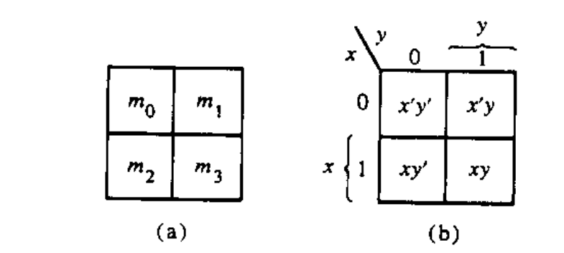
The map method
The map method provides a simple procedure for minimizing Boolean functions.
The map is made up of squares where each square represent a minterm.
We represent each minterm of an equation by ‘1’s
We groups the adjacent ‘1’s in groups of 2, groups of 4 or groups of 8 and so on.
In those grouping try to find the common literal.
The map method is often known as Karnaugh Map or Veitech Diagram. In short we will call it K-map

Slide 30

Two variable map
There are 4 minterm of 2 variable; hence the map is four squares, one for each minterm.
Only 1 bit changes
Only 1 bit changes
00
01
10
11

Slide 31
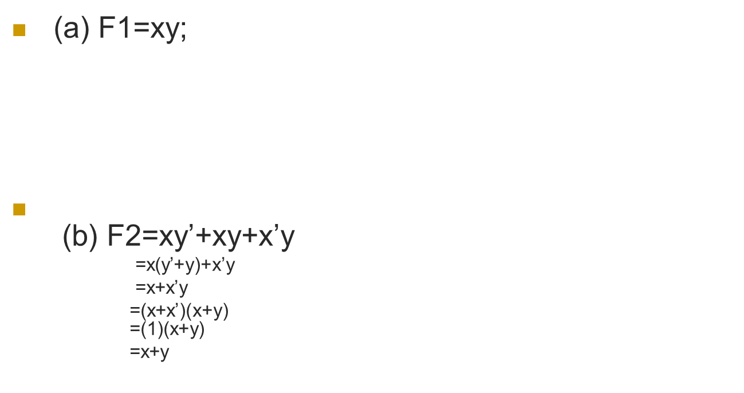
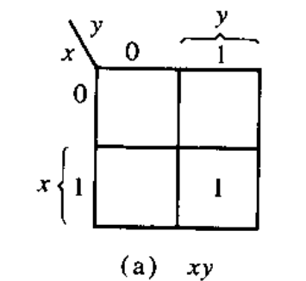
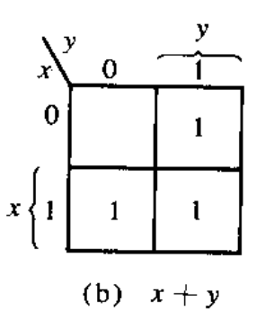
Representing function in K-map

Slide 32
Try it yourself
F=xy’+x’y’+x’y,
Simplify the equation using k-map

Slide 33
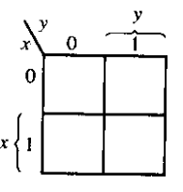
Solution
F=xy’+x’y’+x’y=x’+y’
1
1
1

Slide 34
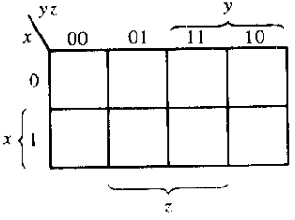
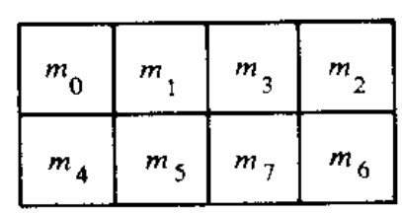
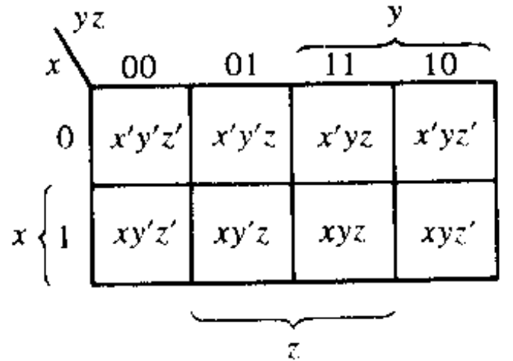
Three variable map
Sequence in 3-variable map is not in binary sequence but in reflected code. In reflected code, at a time only 1 bit changes from 0 to 1 and 1 to 0.
Numbering of minterms follow binary numbers. Example m5 is at 101 i.e. row 1 and column 01.
Note: Any 2 adjacent square differ by 1 variable ( which is primed in one and unprimed in the other )
000
001
011
010
100
101
111
110

Slide 35
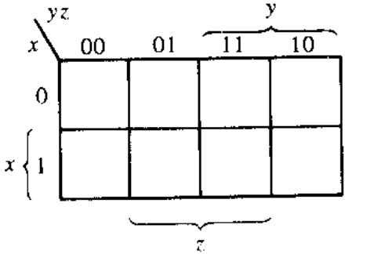
If any 2 adjacent square differ by 1 variable ( which is primed in one and unprimed in the other ) and they are grouped, then any 2 minterms in the adjacent square are ORed, will remove the different term. As a result , we get a single ANDed term of only 2 common literals
F1=∑(5,7)=xy’z+xyz=xz(y’+y)=xz
F2=∑(0,2)=x’y’z’+x’yz'=x’z’(y’+y)=x’z’
1
1
1
1

Slide 36
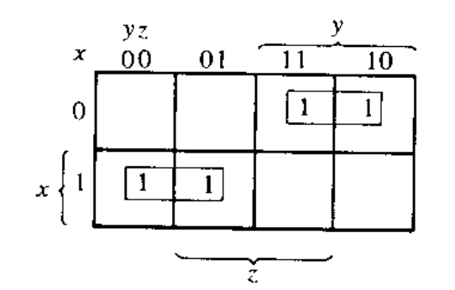
Simplifying functions using k-map
F=∑(2,3,4,5)=x’yz+x’yz’+xy’z’+xy’z
(note: in other words, F= (∑(010,011,100,101) so place ‘1’ in those positions and group the adjacent ones)
F=x’y+xy’
Grouping of 1 can be done in groups of
two ‘1’,four ‘1’,eight ‘1’.…2^n ‘1’.
x’y
xy’

Slide 37
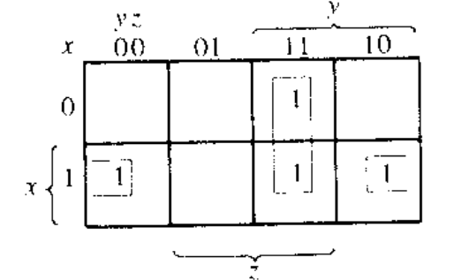
F1=x’yz+xy’z’+xyz+xyz’=xz’+yz
011
100
111
110
yz
Notice even 2 opposite edges of the map are adjacent, thus they can be grouped
xz’

Slide 38
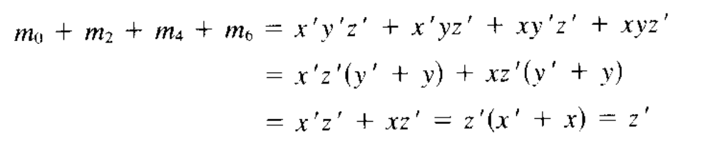
If F=∑(0,2,4,6), then simplify it
000
010
100
110
1
1
=Z’
1
1

Slide 39
Try it yourself
F=∑(0,2,4,5,6), Simplify it.

Slide 40
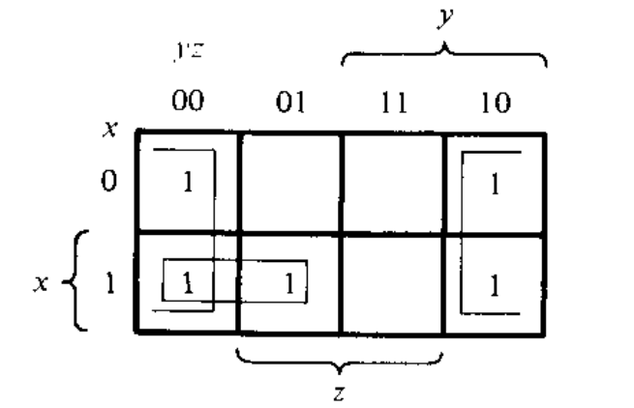
Solution
F= xy’ + z’

Slide 41
Try it yourself:
F=A’C+A’B+AB’C+BC
a) Express it as SOP (i.e. ∑)
b) Simplify it using Kmap

Slide 42
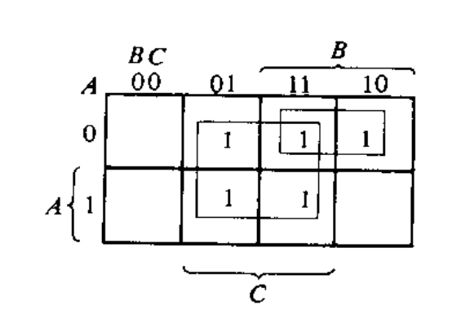
Solution
(a) F= ∑(1,2,3,5,7)
(b)F=C + A’B
To find A’C, coincide A’ (first row) with C( middle 2 column)
To find A’B, coincide A’ (first row) with B( last 2 column)
To find BC, coincide B (last 2 column) with C( middle 2 column)
To find AB’C, is m5( 2nd row 2nd column)

Slide 43
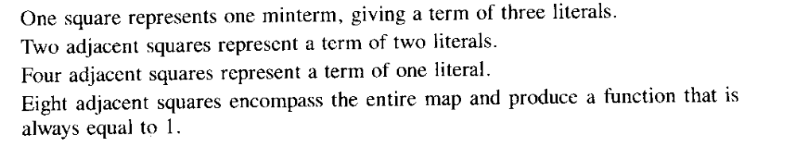
Summary of grouping in 3-variable map

Slide 44
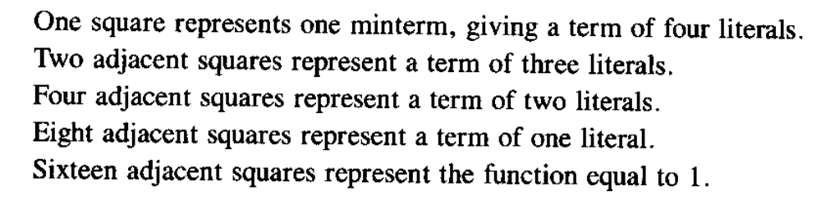
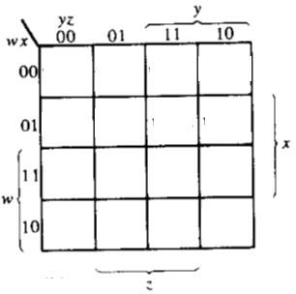
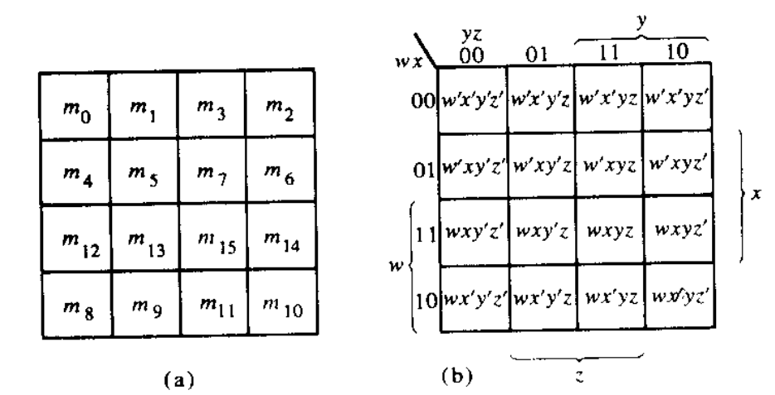
Four variable map
Adjacent squares can be side by side or lie in 4 corner or top-bottom or left-right edge condition. Example, m0 -m2 are adjacent and similarly m3-m11 are adjacent
0000
0001
0011
0010
0100
0101
0111
0110
1100
1101
1111
1110
1000
1001
1011
1010

Slide 45
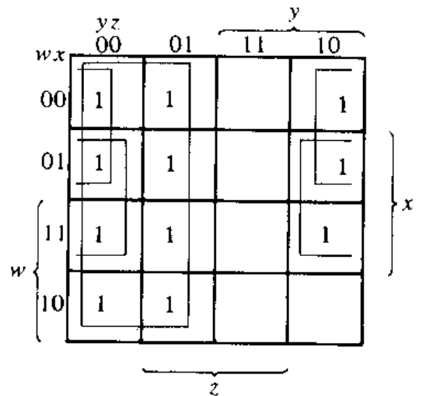
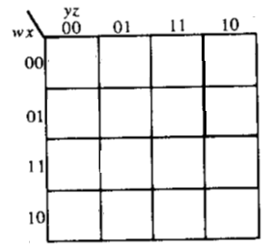
Simplify F=∑(0,1,2,4,5,6,8,9,12,13,14)
Note: it is allowed to use the same ‘1’ more than once.
1
1
1
1
1
1
1
1
1
1
1
F= xz’+ y’+ w’z’

Slide 46
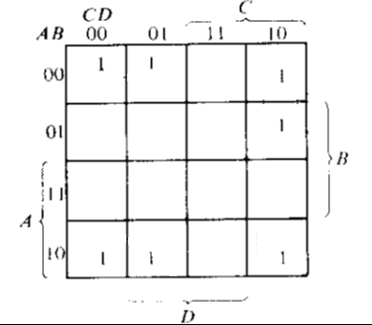
Try it yourself
F=A’B’C’+B’CD’+A’BCD’+AB’C’

Slide 47
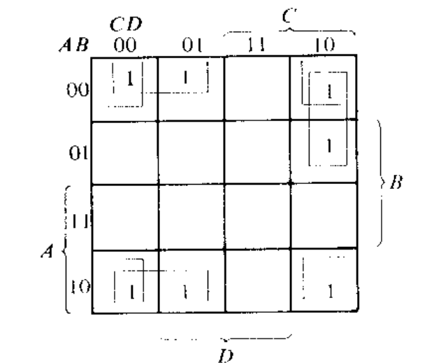
Solution
F=A’B’C’+B’CD’+A’BCD’+AB’C’
F=B’D’+B’C’+A’CD’

Slide 48
Product of Sum (POS) simplification
F is represented with the ‘1’s
-> F’ is represented with the ‘0’s
-> (F’)’ =F so find F’ and then find it’s complement using DeMorgan’s law.
In other word, ‘1’s represent the minterms whereas ‘0’s represent the maxterms.
If Equation is provided in SOP format, mark the ‘1’s and then mark the remaining with ‘0’s. On the other hand, if Equation is provided in POS format, mark the ‘0’s and then mark the remaining with ‘1’s. Once marking is done, function can be simplified in SOP or POS format.

Slide 49
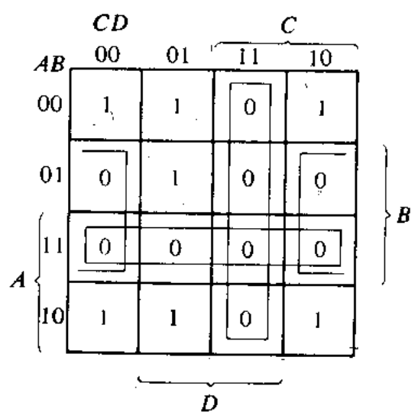
SOP to POS
SOP-> F=∑(0,1,2,5,8,9,10)
Combining ‘1’s we get
F=B’D’+B’C’+A’C’D
Combining ‘0’s we get
F’=AB+CD+BD’
Applying De-morgan
F=(A’+B’)(C’+D’)(B’+D) <-POS

Slide 50
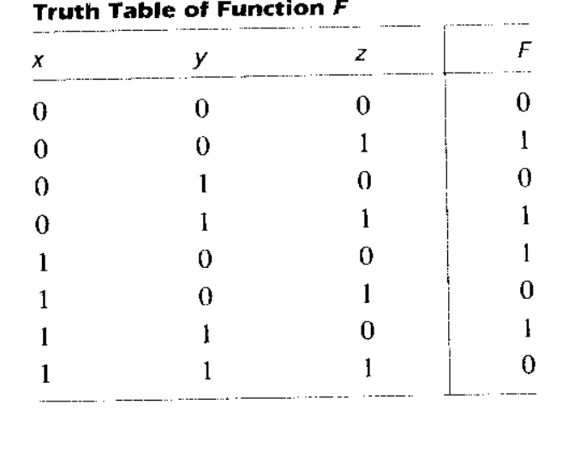
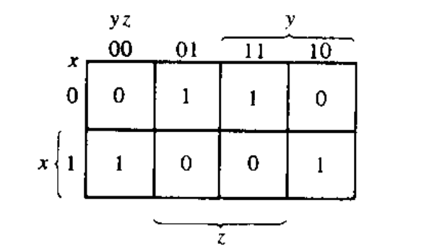
If SOP: ∑(1,3,4,6)
then POS: ∏(0,2,5,7)
So grouping ‘1’s, F=x’z+xz’
Grouping ‘0’s, F’=xz+x’z’
therefore, F= (x’+z’)(x+z)

Slide 51
Don’t Care condition
Don't cares in a Karnaugh map, or truth table, may be either 1s or 0s, as long as we don't care what the output is for an input condition we never expect to see.
We plot these cells with a special sign, ‘X’, among the normal 1s and 0s.
When forming groups of cells, treat the don't care cell as either a 1 or a 0, or ignore the don't cares. This is helpful if it allows us to form a larger group than would otherwise be possible without the don't cares.
There is no requirement to group all or any of the don't cares. (i.e. do not make any group only consisting the don’t cares). Only use them in a group if it simplifies the logic.

Slide 52
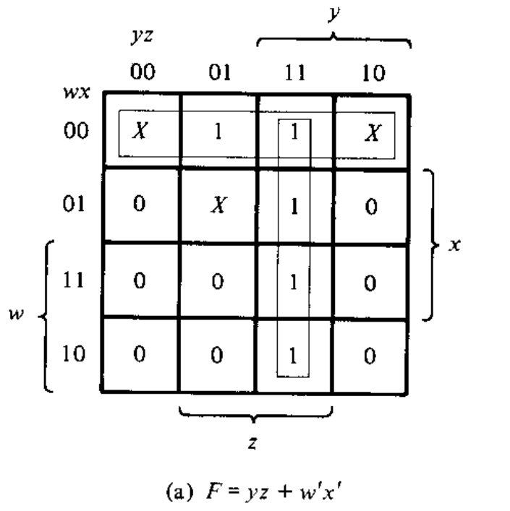
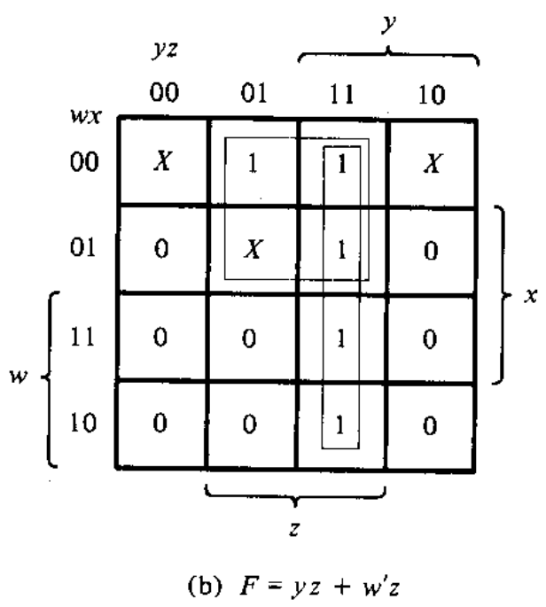
Simplify F(w,x,y,z)= ∑(1,3,7,11,15) and don’t care d(w,x,y,z)= ∑(0,2,5)
Solution: Even though 2 solutions are not same, but either 1 is acceptable. Such scenario only applicable for Don’t care scenarios!

Slide 53
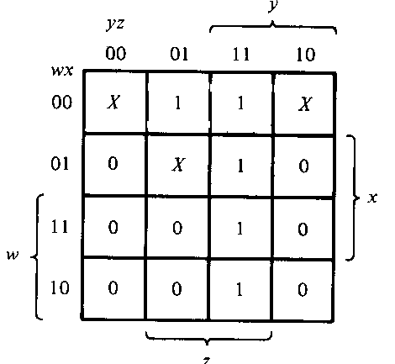

Complement of the function and POS considering don’t cares
F’=z’+wy’
F=(z)(w’+y)

Slide 54
APPLICATIONS OF K-MAP

Slide 55
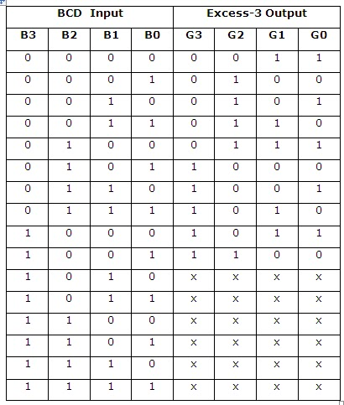

Example 1: Design and draw the circuit diagram of BCD to Excess-3 code converter
Q1.Treat each W, X, Y and Z as a function and write them as SOP
Q2. Based on the SOP, draw the circuit diagram of BCD to Excess-3 code converter
W X Y Z
Any value higher than 9 will result into don’t care output

Slide 56
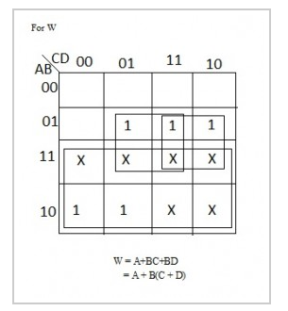
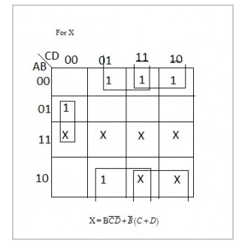
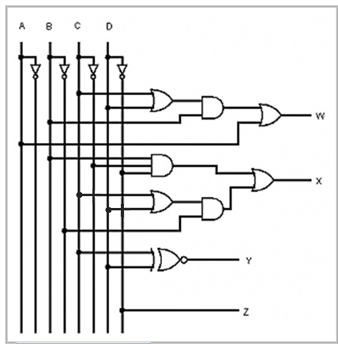
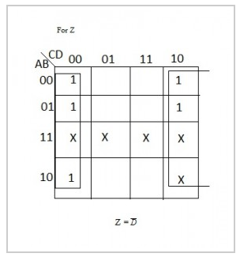
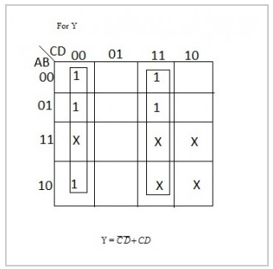

Slide 57
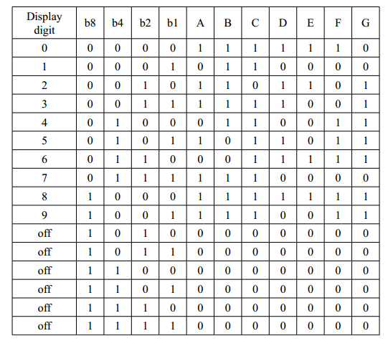
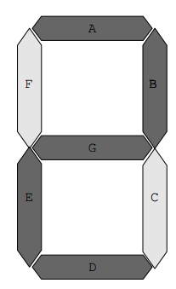
Example 2: 7 segment display board

Slide 58
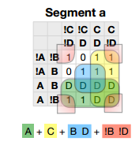
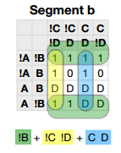
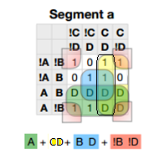
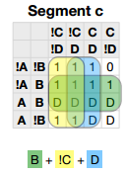
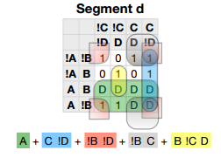




Slide 59
Try it by your self
A car garage has a front door and one window, each of which has a sensor to detect whether it is open. A third sensor detects whether it is dark outside. A security system for the garage follows this rule: the alarm rings if the alarm switch is turned on and either the front door is not closed or it is dark and the side window is not closed.

Slide 60
Solution
SwitchOn | Door | Window | Dark | AlarmRing
0 | 0 | 0 | 0 | x
0 | 0 | 0 | 1 | x
0 | 0 | 1 | 0 | x
0 | 0 | 1 | 1 | x
0 | 1 | 0 | 0 | x
0 | 1 | 0 | 1 | x
0 | 1 | 1 | 0 | x
0 | 1 | 1 | 1 | x
1 | 0 | 0 | 0 | 0
1 | 0 | 0 | 1 | 0
1 | 0 | 1 | 0 | 0
1 | 0 | 1 | 1 | 1
1 | 1 | 0 | 0 | 0
1 | 1 | 0 | 1 | 0
1 | 1 | 1 | 0 | 1
1 | 1 | 1 | 1 | 1
WDk
SDr
X
X
X
X
X
X
X
X
0
0
1
1
0
0
1
0
AlarmRing=WDk+WDr
Assuming
AlarmRing = 1 if Alarm rings, 0 otherwise.
Switch On = 1 if alarm switch is on, 0 otherwise.
Door = 1 if door is not closed, 0 otherwise.
Window = 1 if window is not closed.
Dark = 1 if it is dark outside, 0 otherwise.

Slide 61
UNIVERSAL LOGIC GATES

Slide 62


NAND
NOR

Slide 63




Using NAND
NOT
Gate
OR
Gate
NOT
Gate
AND
Gate

Slide 64




Using NOR
NOT
Gate
OR
Gate
NOT
Gate
AND
Gate

Slide 65



If an expression is given, represent it using AND,OR and NOT gates
Draw each gate with equivalent NAND or NOR representation
Remove any 2 cascading inverters
Remove inverters from single input connection and replace input with its complement.
Use NAND to represent F=A(B+CD)+BC’

Slide 66


If an expression is given, represent it using AND,OR and NOT gates
Draw each gate with equivalent NAND or NOR representation
Remove any 2 cascading inverters
Remove inverters from single input connection and replace input with its complement.
Use NOR to represent F=A(B+CD)+BC’

Slide 67
A Must Self study from the book
Morris Mano: Chapter 3.6 (NAND and NOR implementation )to Chapter 3.7 (Other two level implementation)

